Slide 1
Big Mountain Resort
Ticket Price Strategy
Presented by Belinda Lee
Jan 2021

Slide 2
Current Conditions
Today
Our ticket prices are set based competing resorts, and does not take into account the facilities that make Big Mountain unique. In fact, we have no idea which features in our resort are important to customers. We would like to raise our ticket price, but set it to the value that our resorts provide through the facilities.
Analysis Goal
How can we optimize Big Mountain Resort’s ticket price to increase revenue by capitalizing on its facilities (such as additional chair lifts, open trails, vertical drop, etc.) while decreasing operations cost for facility items that are less impactful to the total ticket price throughout this ski season?

Slide 3
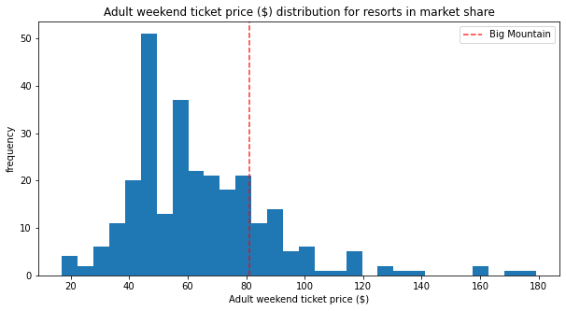
Increase ticket prices and adjust features
Model predicted ticket price: $95.87
Mean square error: 10.39
Current ticket price: $81
The modeled ticket price shows there is room to increase current ticket cost, even when accounting for error.

Slide 4
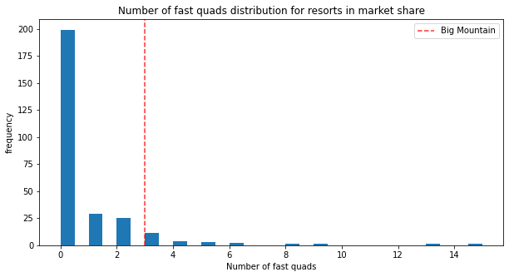
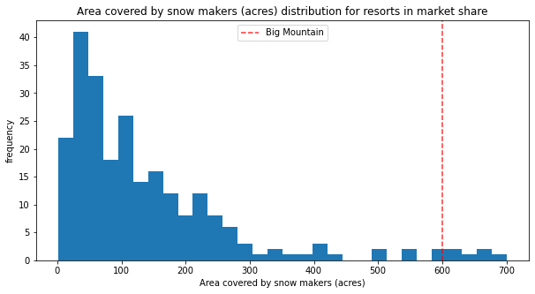
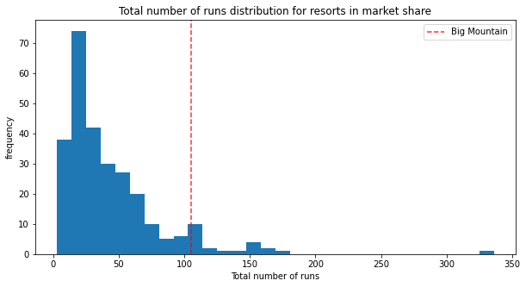
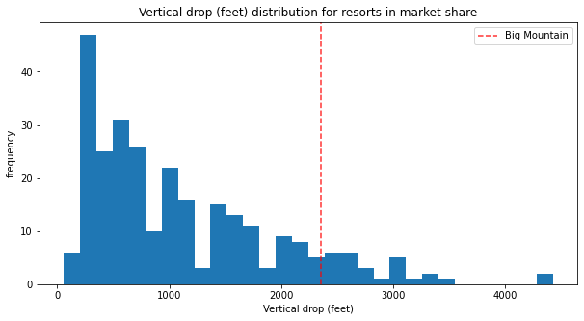
Features that impact ticket price
Notes:
These are the four features with the highest impact on ticket price. The charts plot the number of resorts with the quantity of that feature. The red line shows where Big Mountain Resort falls. As you can see, Big Mountain resort currently is on the high end when it comes to having features that impact cost. From this, we can tell that the features we have on our resort are valuable to our customers.

Slide 5
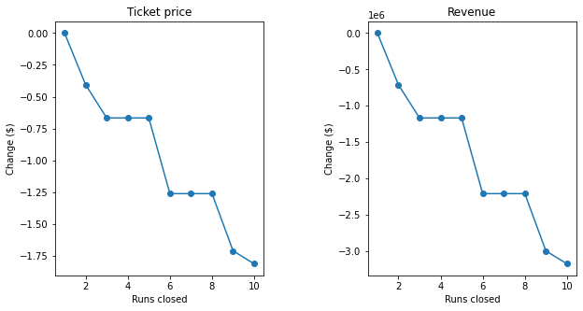
Add 1 run and increase vertical drop by 150ft.
Closing 2-3 runs will impact ticket price, but when closing 3-5, ticket price is not impacted but could save on operation cost.
Adding 1 run, increasing vertical drop by 150 ft, and adding 1 chair lift increases predicted ticket price by $1.99. Over the season that is $3.47m

Slide 6
$3.47M
Conclusion: Big Mountain Resort has room to increase ticket price. By increasing it by $1.99, this could increase the season revenue by $3.4 million.
We do this by adding 1 run, increasing vertical drop by 150ft. and addition 1 chair lift.

